Slide 1

Time series analysis for CarSales using prophet with ibm cloud
TEAM
CSE-09
TEAM MEMBERS
19R11A0573-CHANDAN SAI
19R11A0575-MANASWINI
19R11A0576-AKASH REDDY
19R11A0578-VARUN RAJ
19R11A0579-LASYA PRIYA

Slide 2
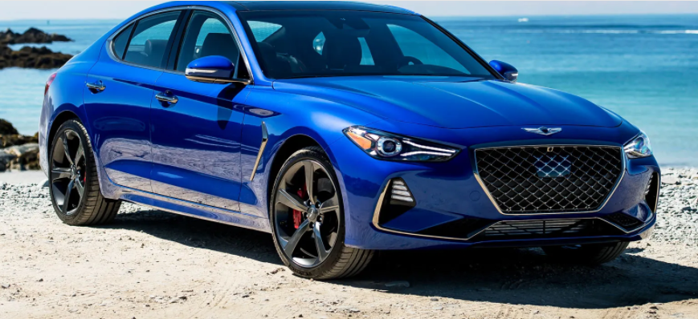
Time Series Analysis For Car Sales Forecasting Using Prophet With IBM Cloud
Forecasting or Predicting the sale value helps the investors to invest in such a time where profits can be maximum. This project provides guidance to individuals who are willing to invest or buy a car and help them in knowing the price of a day using the prophet library. It is built on the monthly sales data from 1960 - 1968. Time series analysis is made on the data for accurate predictions.

Slide 3
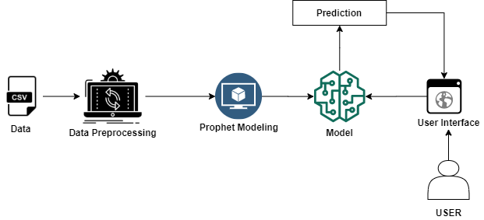
Technical Architecture:

Slide 4
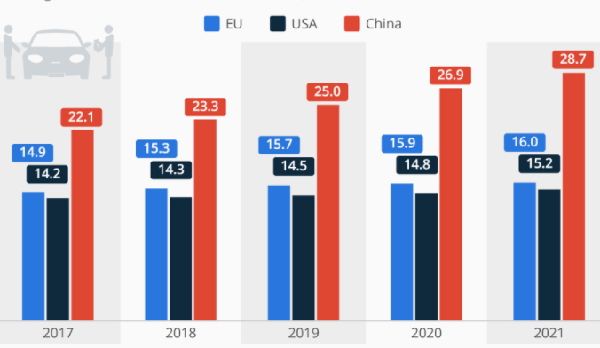
STEPS FOR THE PROJECT:
1.Data Collection
2. Data Preprocessing
3. Model Building
4. Application Building
5. Deploy In IBM Cloud

Slide 5
1.Data Collection
This dataset contains many columns. But we are interested in two columns for time series analysis
month
Sales
2. Data Preprocessing
Data Pre-processing includes the following tasks:
Importing the required libraries
Importing the dataset
Analyze the data
Resampling the dataset
Preprocessing the data
Taking care of Missing Data
Prophet Library naming convention
Data visualization

Slide 6
3. Model Building
Now that our data is ready for training let's train the model Model Building Includes:
Model Fitting
Making Future Predictions
Obtaining the Forecasts
Plotting the Forecasts
Model Evaluation
Saving the model

Slide 7
4. Application Building
This activity lets you create a Flask Web application where the user can select the specific date to forecast the sales on the selected date. To accomplish the task you should build the required HTML pages and styling sheets as well as backend scripting files.
5. Deploy In IBM Cloud
→ we will be deploying our flask app in IBM Cloud as a cloud foundry application.
→We will be creating a python flask app in IBM cloud and we will be using Cloud Foundry CLI to deploy in IBM Cloud.

Slide 8
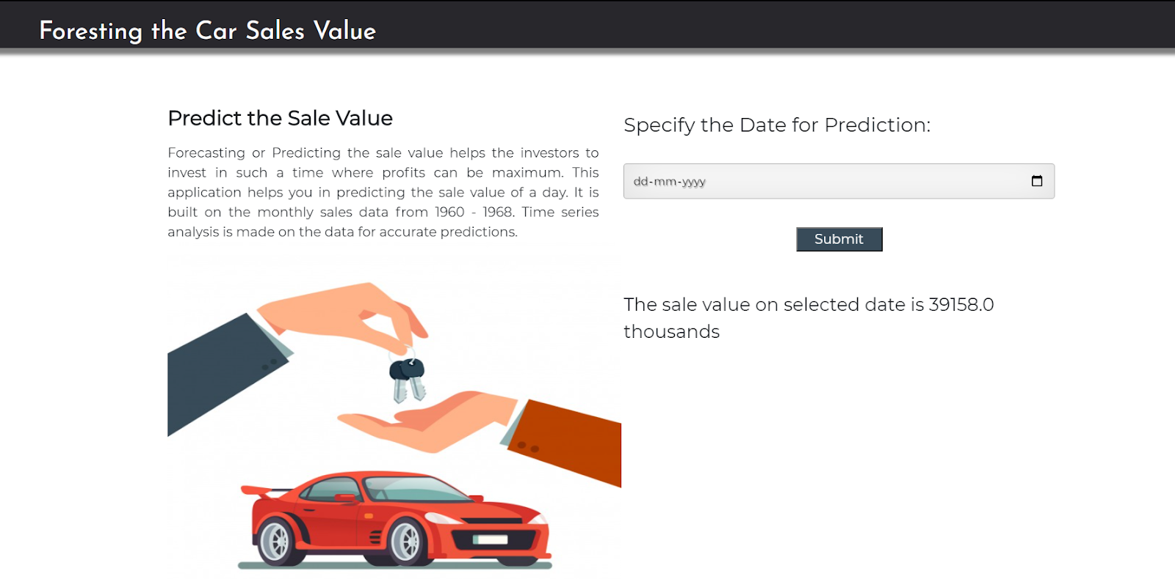
Final outlook of project:

